Slide 1

ADSAI: Data Science 1: SDG Mini-Conference
Bram Heijligers & Nitin Bhushan

Slide 2

Maintain eye contact and smile
Makes them feel more:
personally involved;
important;
connected to the topic.
Makes you look more:
Confident;
Passionate;
Enthusiastic.
Don’t look at the floor!
Notes:
In order to give each of your listeners the feeling of being important and to make them feel personally addressed, it is particularly important to maintain eye contact with the audience during the presentation. Not only does this exude confidence, but it also helps your audience to connect with you and your subject. It also helps you feel less nervous. Easier said than done right? Here's what can help:

Slide 3
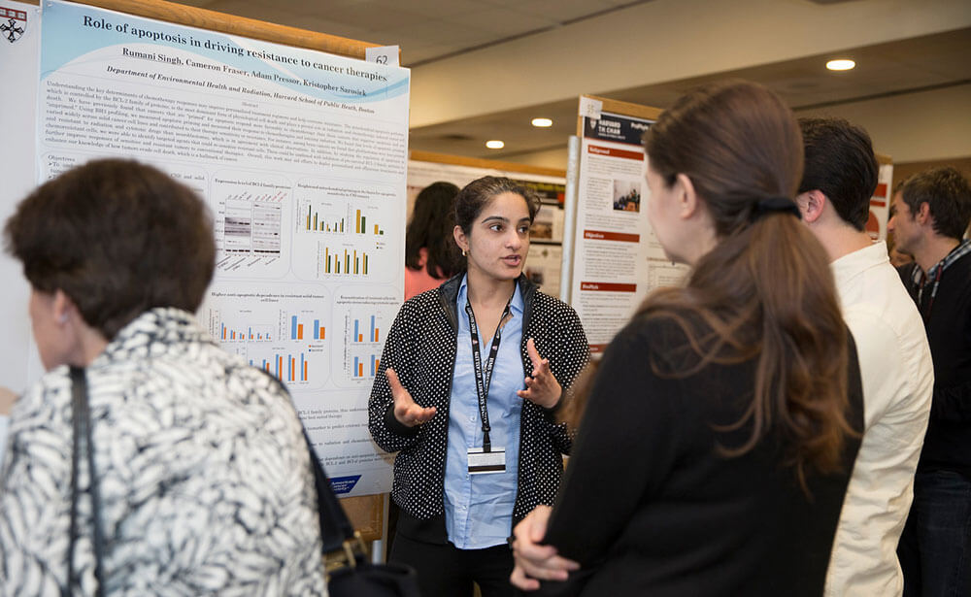
Use of gestures and facial expressions
Do:
stand up straight;
emphasize messages using your hands;
take an open and friendly posture: look approachable;
smile; mildly.
Avoid:
avoid crossed arms;
hands behind your back;
hands in your pockets.
Notes:
To emphasize the content of your presentation, it is advisable to use appropriate gestures and body language to get your message across. Avoid crossed arms, hands behind your back, or in your pockets during a presentation. Always stand up straight, and try not to appear tense or stressed. You can do that by using your hands and arms to emphasize what you are saying and get your message across. Your facial expressions should always be friendly and open. Smile and show that you enjoy the topic and you are confident in the information you are presenting.

Slide 4

Avoid distractions
Avoid:
looking on phone;
have unnecessary stuff around;
have something in your hand.
Notes:
To avoid distractions for you and the audience, get into the habit of putting down tools you don't need! That way you will not be tempted to deal with them in the first place. You will also have your hands free for gestures.

Slide 5

Be prepared: know your topic
Do:
Know your topic well; you made the poster
Speak freely
Use analogies and anecdotes
Avoid:
filler words
Difficult terms
Notes:
If you prepare and know your stuff well before the presentation, you will feel more relaxed and confident while presenting and it will also improve your body language.
The headline speaks for itself. To make the presentation as lively and enjoyable as possible, you should avoid reading it off. Speak freely, slowly, and clearly.
Make sure to use appropriate analogies and anecdotes and avoid foreign words, empty phrases, and clichés. If you have to use foreign words, explain them in a handout or footnote within the presentation.

Slide 6

Use effective pauses
Do:
Give your audience time to look at your poster
Avoid:
Continually engaging the audience in conversation out of awkwardness
Notes:
Give your audience enough time to read and understand the content of your poster!

Slide 7

Don't fight the stage fright & take deep breaths
Do:
Monitor how you feel
Take calm deep breaths
Accept how you feel
Remember your passion/excitement for your topic
Avoid:
Thinking about what can go wrong
Thinking about how nervousness or bad feeling are unhelpful
Notes:
Stage fright is one of the biggest enemies of a presentation, yet you shouldn't let yourself be a victim of your feat. Do not fight it, rather address your fear and try and accept it, and transform it into positive enthusiasm. Don't let your stage fright get you all worked up and nervous. Take a couple of deep breaths to get oxygen to your brain and relax your body.

Slide 8
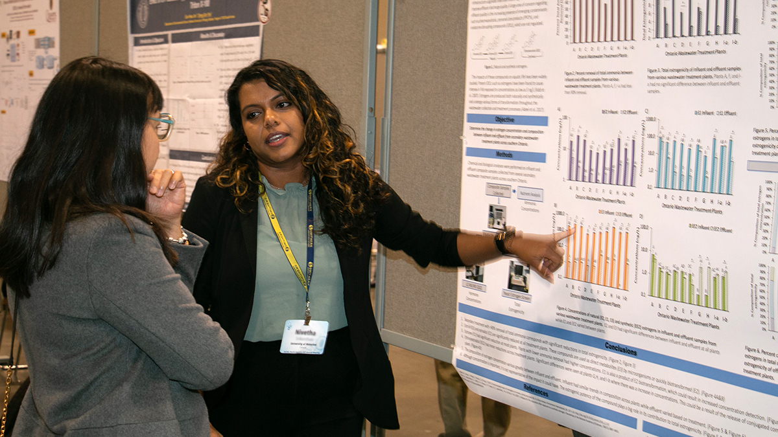
Choose the right angle on standing during a presentation
Do:
Stand next to your poster
Avoid:
Standing in front of your poster

Slide 9

Any questions?

